Slide 1

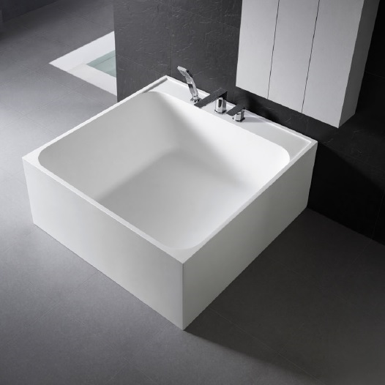
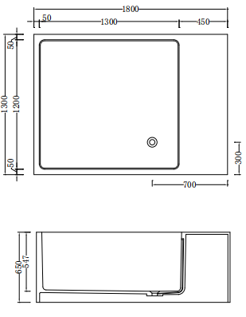

Code: B-207c
Material: Isostone - 70% Limestone Composite
Size: Warranty:
W 1800 x D 1300 x H 650 mm
10 Years
Features:
Freestanding Bath
Smooth matt white finish (gloss by custom order)
Italian Design & Engineering
Solid Material (All White only)
Suits 40mm waste
Scratch and Stain resistance
Repairable Material
Australian Standard (SAI) AS/NZS 3718:2003
ROMY
Specifications:
Crate size:
W 1930 x D 1430 x H 860 mm
Gross Weight: 330Kg
1300 898 889
www.acsbathrooms.com.au
As part of ACS commitment to quality products. Information provided in this data sheet is representative of the actual productt aavailable at the time of printing. Due to our commitment to continuous product design and development, the designs and specifications depicted are subject to change withoutt notice. Please confirm all particulars with your ACS sales consultant prior to purchase. Each product is covered by a limited warranty. Please see our website for full terms and conditions. This drawing remains the
property of ACS and should not be copied or distributed without ACS consent. © 2010 All Dimensions are approximate in mm and are not to scale.

